Slide 1
What’s the Right Price? An In-Depth Analysis into Predicting Sale Price

Slide 2
Introduction
According to Zillow (a leading real estate company), median home prices are projected to rise in the U.S. market.
Buyers can be left with an overvalued home once the realtor has claimed his or her commission on the sale.
Buyers need a tool to estimate what the actual sales price of a home should be. With an estimation tool, buyers won’t have to rely solely on the word of a realtor or a seller that a home is appropriately priced

Slide 3

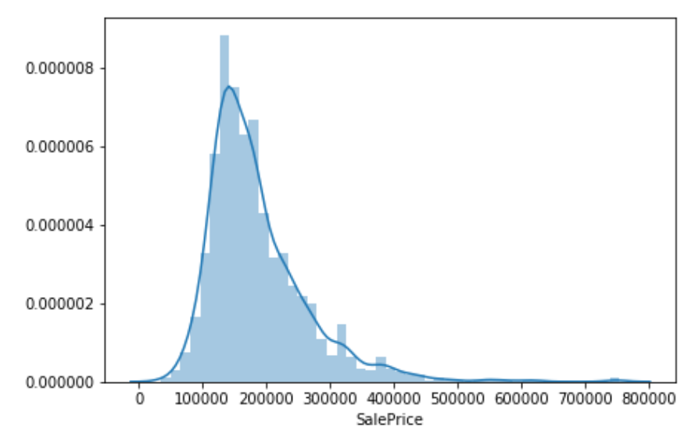
Exploratory Data Analysis

Slide 4
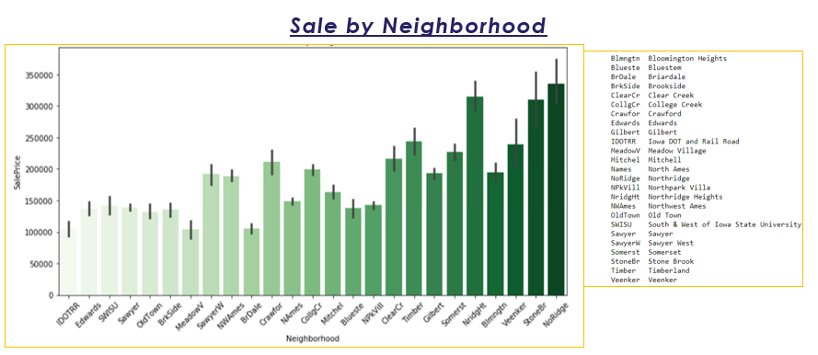
Sales Price by Neighborhood
The ‘Sales Price by Neighborhood’ Plot shows ‘NoRidge’, ‘StoneBr’, and ‘NridgeHt’ are the neighborhoods with the highest average sales price.
It seems that ‘BrDale’, ‘MeadowV’, and ‘IDOTRR’ are neighborhoods with the lowest average sales price.

Slide 5
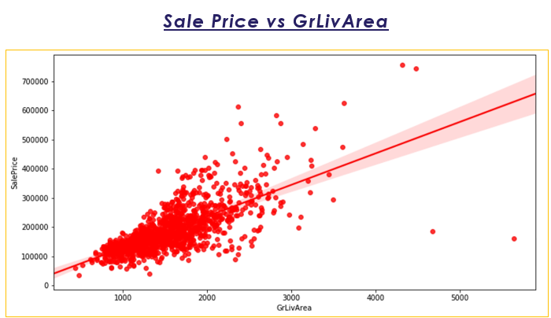
More space!
From the data, we can see that sale price and GrlivArea are positively correlated.
The are some outlier that don’t follow the trend.

Slide 6
Statistical Inference
The data set I used to create a prediction model has over 70 predictor variables. The dataset need to be limited to the variables that have a strong relationship sale price

Slide 7
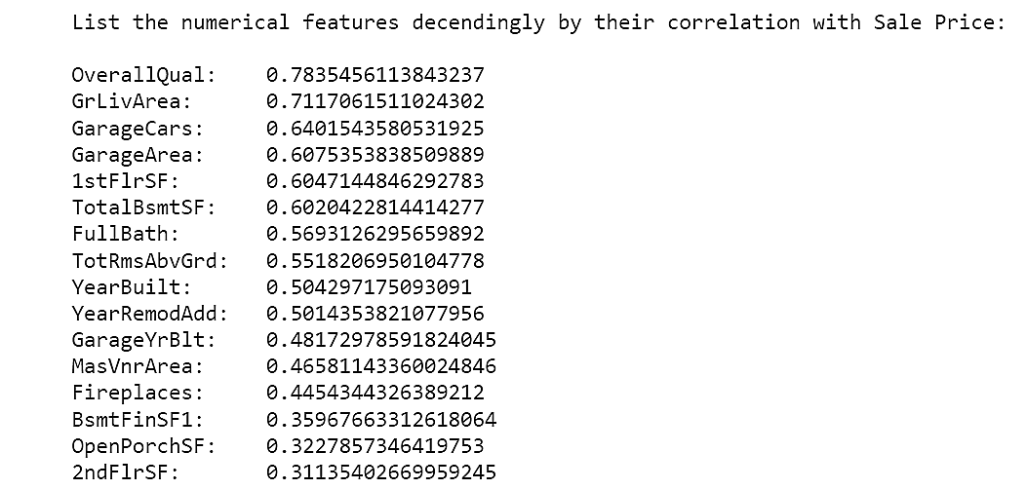
Test of Numerical columns
GrLivArea, GarageCars, and OverallQual are positively correlated with Sale Price.
The correlation of each variable and Sale price needed to be test to prove that this correlation isnt by chance.
Using python code, I conducted a hypothesis test of all numerical columns

Slide 8
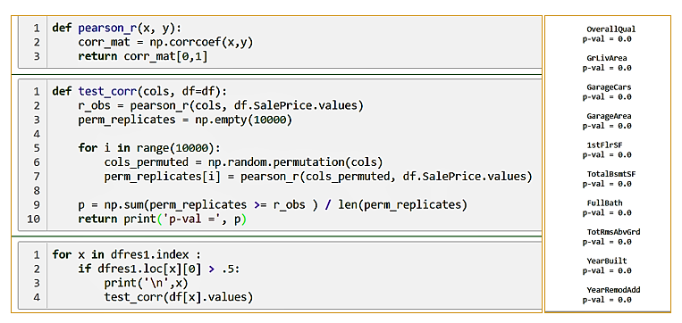
Above is the code used to execute my hypothesis test of numerical columns in the data frame.

Slide 9
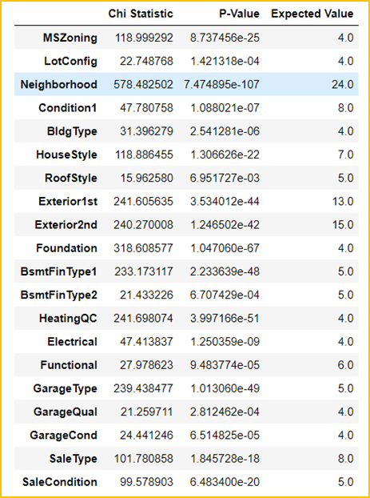
Testing categorical Variables
Next, tested the categorical variables in the data set
Using a chi squared test, I tested the significance of each categorical variable in predicting sale price
The data frame shows the variables that passed the test of significance.

Slide 10
Model Construction
Ridge Model
Lasso Model
Elastic Net Model with Ada Boosting
I fit the model with all the variables that were determined to be statistically significant.
R² Train : .92
R² Test : .78
RMSE : .125
Hoping to offer a better prediction on the test set, I tried to use a lasso regression algorithm that uses a subset of the strongest feature to make predictions.
R² Trian: .91
R² Test : .77
RMSE: .124
I finally ended up using Elastic Net Algorithm with Ada boosting. The latest model offered the best score on the training set.
R² Trian: .89
R² Test: .82
RMSE: .145

Slide 11
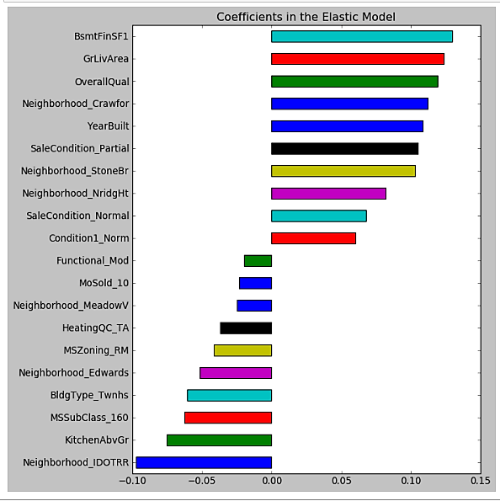
Key Variables

Slide 12
So What Influences Sale Price?
Location
Many of the Top predictors are time to the location of the home. Neighborhood and MS Zoning played key parts in predicting sale price.
Homes located in Neighborhood such as North Ridge Heights tend to have high Sale price when compared to other neighborhoods
Living Space
The more space in the home the better. Sale Price are influenced by variables associated with the living space of the home.
Building Type and Year Built Matters
2 story families tend to have high sale prices expect to pay top dollar.

